Slide 1
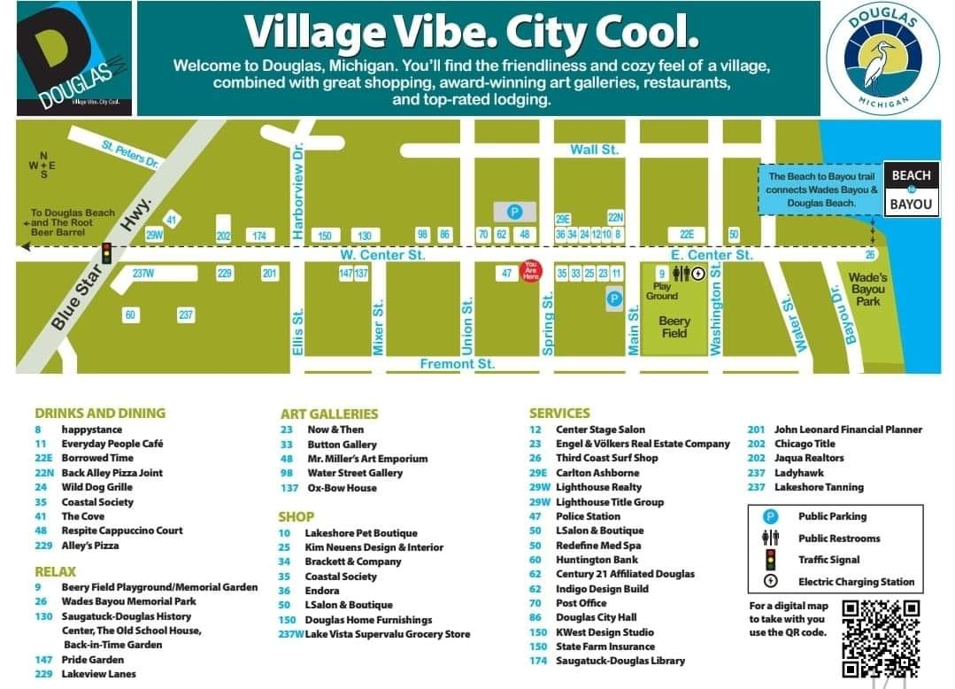
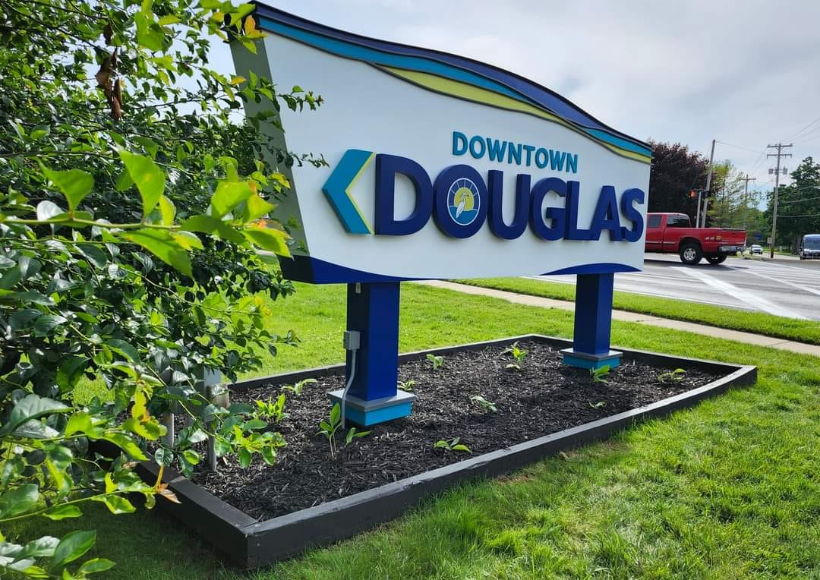
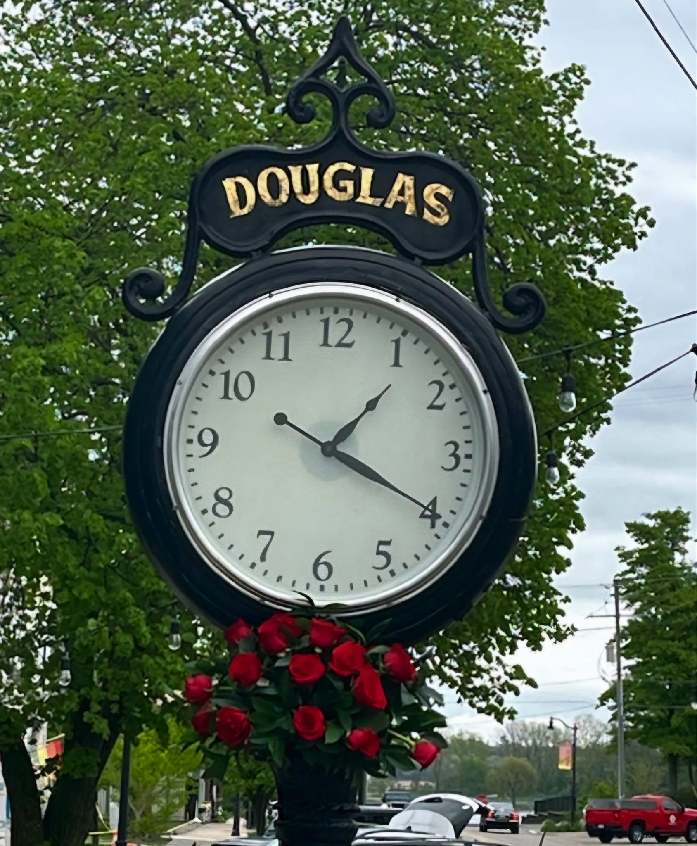
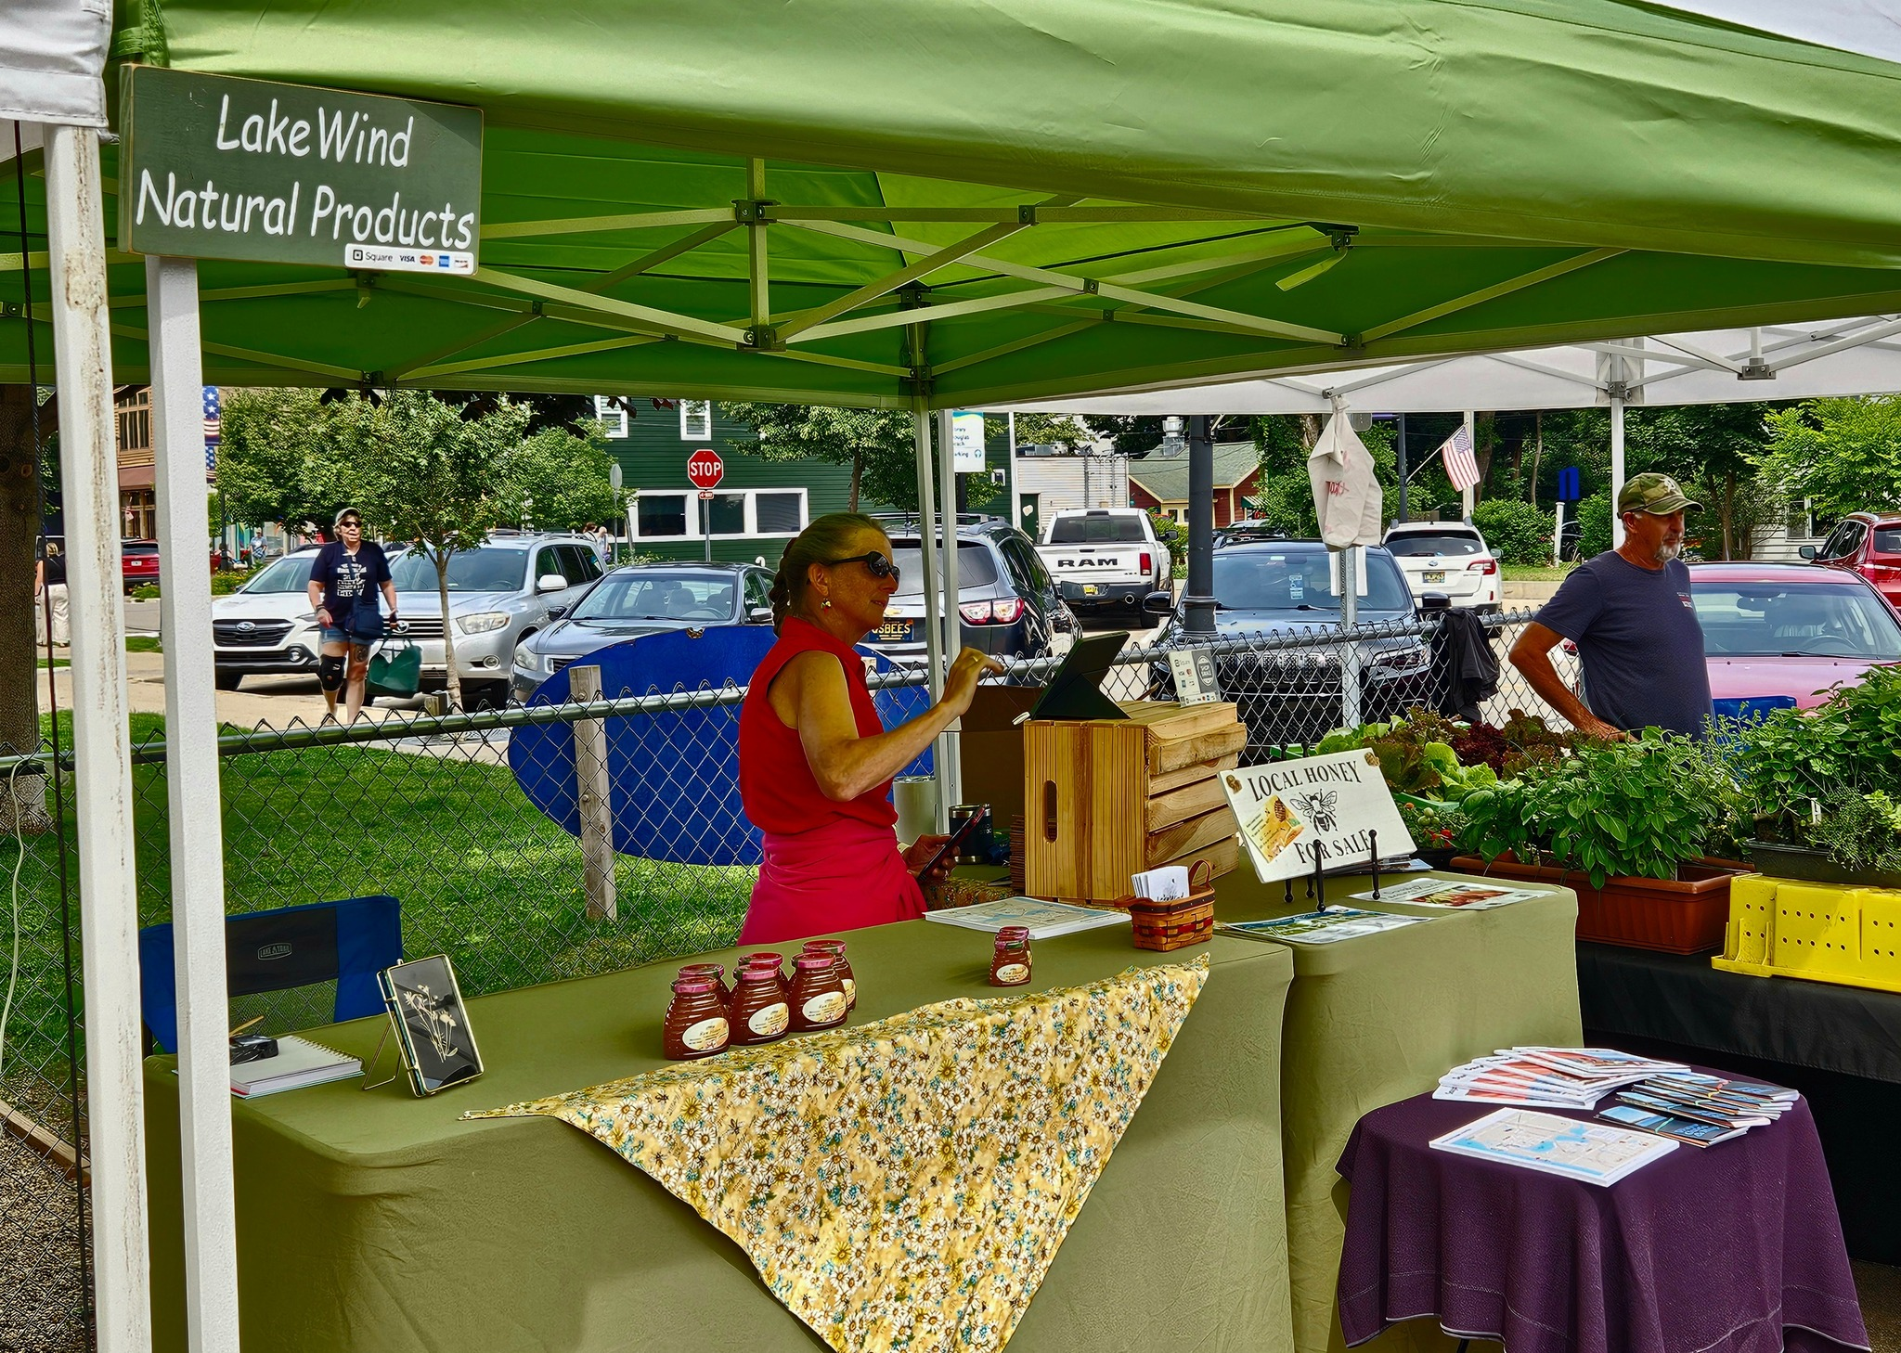
City of Douglas Downtown Development Authority
2024 Informational Meeting & Annual Report 12/18/2024

Slide 2
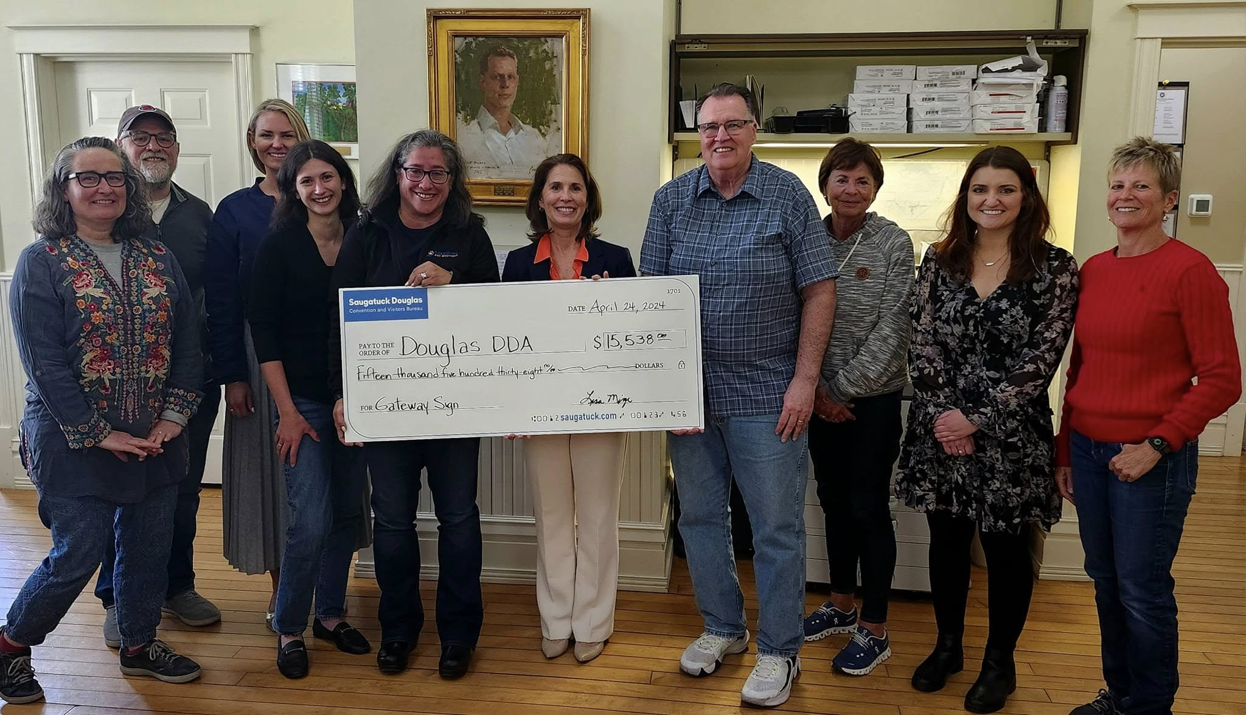
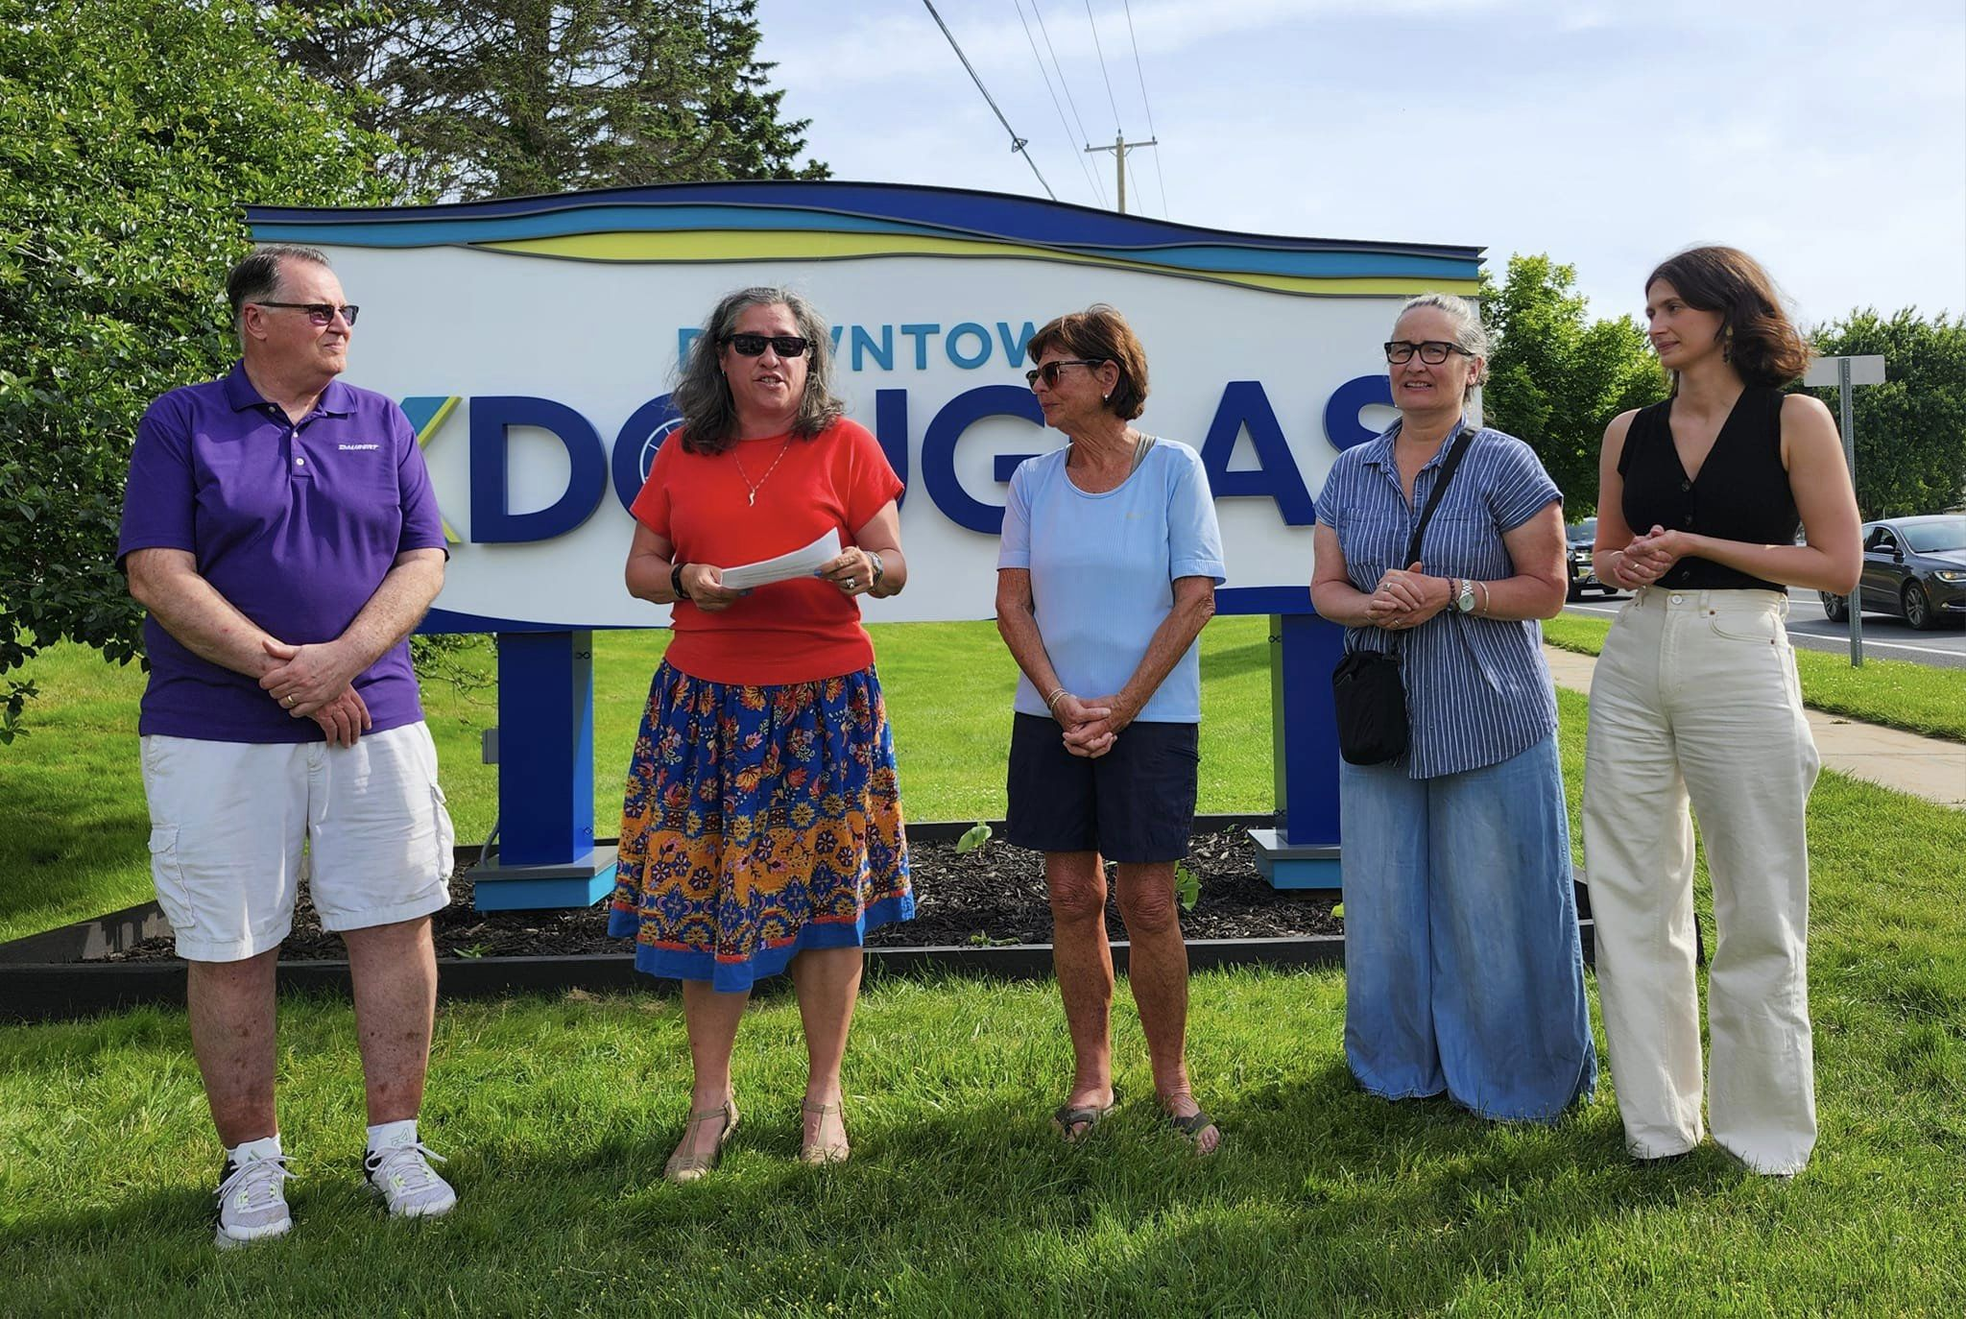
Douglas Downtown Development Authority Board Members
Aleshia Balmer-Chair
Randy Walker- Vice Chair/Council Appointment
Dave Laakso-Treasurer
Maggie Bandstra-Secretary
Cathy North-Mayor
Kabri Martyniek-Member
Mark Postilion-Member
Beth Stefanchik-Member
Lauren Vonk-Member
Administration:
Lisa Nocerini-City Manager/DDA Assistant
Sean Homyen, Planning & Zoning Administrator/DDA Assistant

Slide 3
Purpose of a Downtown Development Authority
The purpose of the Douglas Downtown Development Authority (DDA) is to enhance and support the economic vitality and appeal of Downtown Douglas. This is achieved through various efforts aimed at revitalizing the downtown area, fostering business growth, and creating a welcoming and vibrant environment for residents, visitors, and entrepreneurs.
Key responsibilities of the DDA include:
Economic Development: Supporting and attracting businesses to the downtown area, helping create a strong local economy.
Public Improvements: Facilitating improvements to infrastructure, public spaces, and aesthetics to ensure downtown remains attractive and accessible.
Community Engagement: Organizing events, promotions, and programs that engage the community and draw visitors to downtown businesses.
Partnerships: Collaborating with local organizations, business owners, and governmental entities to align efforts and resources.
Historic Preservation: Preserving the unique character and charm of Downtown Douglas while encouraging thoughtful growth and modernization.
Through these efforts, the DDA plays a vital role in strengthening the identity of Douglas as a destination and supporting the overall quality of life for its community.

Slide 4
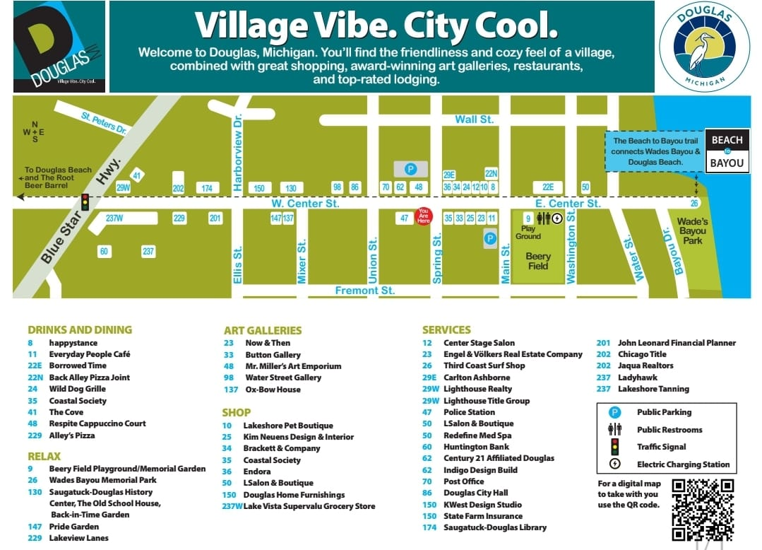
Downtown Douglas DDA Map

Slide 5
Douglas DDA Financial Report as of December 2024: Fund Balance $108,957.15
 | 2024-2025 Approved Budget | Activity for November 2024 | 2024-2025 YTD Activity | Budget Remaining to Earn/Spend
REVENUES
TAX INCREMENT RECAPTURE | $ 62,807.00 | $ 4,740.27 | $ 56,141.30 | $ 6,665.70
OTHER INCOME | $ - | $ - | $ 804.49 | $ (804.49)
INTEREST INCOME | - | - | 1,162.22 | (1,162.22)
TOTAL Revenues | $ 62,807.00 | $ 4,740.27 | $ 58,108.01 | $ 4,698.99
EXPENSES
DDA ADMINISTRATION | $ 9,000.00 | $ - | $ - | $ 9,000.00
TRAINING FUNDS | 1,000.00 | - | - | 1,000.00
BUSINESS INCENTIVE PROGRAM | 5,000.00 | - | 284.16 | 4,715.84
CONTRACTUAL ENGINEERING | - |  |  | -
COMMUNITY PROMOTIONS | 27,000.00 | 4,988.52 | 7,966.55 | 19,033.45
DUES/FEES/PUBLICATIONS | - | - | - | -
CAPITAL OUTLAY (Detail Below) | 15,560.00 | 6,443.75 | 6,642.65 | 8,917.35
TOTAL Expenditures | $ 57,560.00 | $ 11,432.27 | $ 14,893.36 | $ 42,666.64
SUMMARY: | - | - | -
REVENUES: | $ 62,807.00 | $ 4,740.27 | $ 58,108.01 | $ 4,698.99
EXPENDITURES | 57,560.00 | 11,432.27 | 14,893.36 | 42,666.64
BUDGET NET INCOME (LOSS) | $ 5,247.00 | $ (6,692.00) | $ 43,214.65 | $ (37,967.65)
Capital Outlay Detail | 2023-2024 Approved Budget | Activity for November 2024 | 2024-2025 YTD Activity | Budget Remaining to Spend
Unallocated | $ 15,560.00 | $ 6,443.75 | $ 6,642.65 | $ 8,917.35
 |  |  |  | $ -
 |  |  |  | $ -
 |  |  |  | $ -
Total Capital Budget | $ 15,560.00 | $ 6,443.75 | $ 6,642.65 | $ 8,917.35

Slide 6
A closer look at the budget!
Tax Increment Recapture: $62,807.00
Year to date activity: $56,141.30
Budget Remaining to earn/spend: $6,665.70
Expenses:
City Administration Staffing: $9000.00
Training Funds: $1000.00
Business Incentive Program: $5000.00
Contractual Engineering: $0.00
Community Promotions: $27,000.00
Year to date activity: $7,966.55
Budget Remaining to spend: $19,033.45
Dues/Fees/Publications: $0.00
Capital Outlay: $15,560.00
$8,917.35
Budget Remaining to earn/spend: $8,917.35
Revenues:
$62,807.00
Year to date activity: $58,108.91
Budget Remaining to earn/spend: $4,698.99
Expenditures:
$57,560.00
Year to date activity: $14,893.65
Budget Remaining to earn/spend: $42,666.64
Total Capital Budget:
$15,560.00
Year to date activity: $6642.65
Budget Remaining to earn/spend: $8,917.35

Slide 7
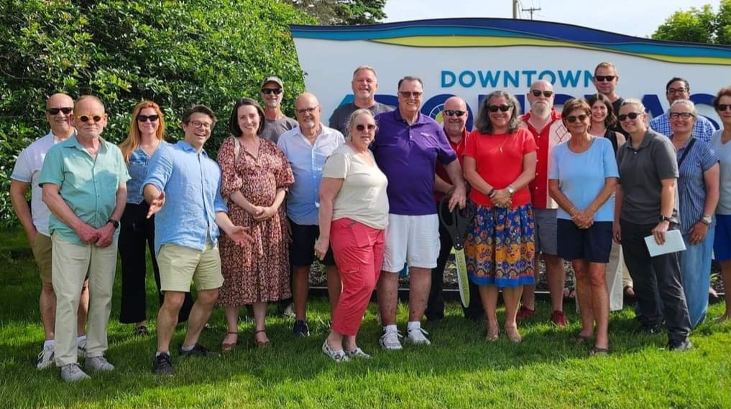
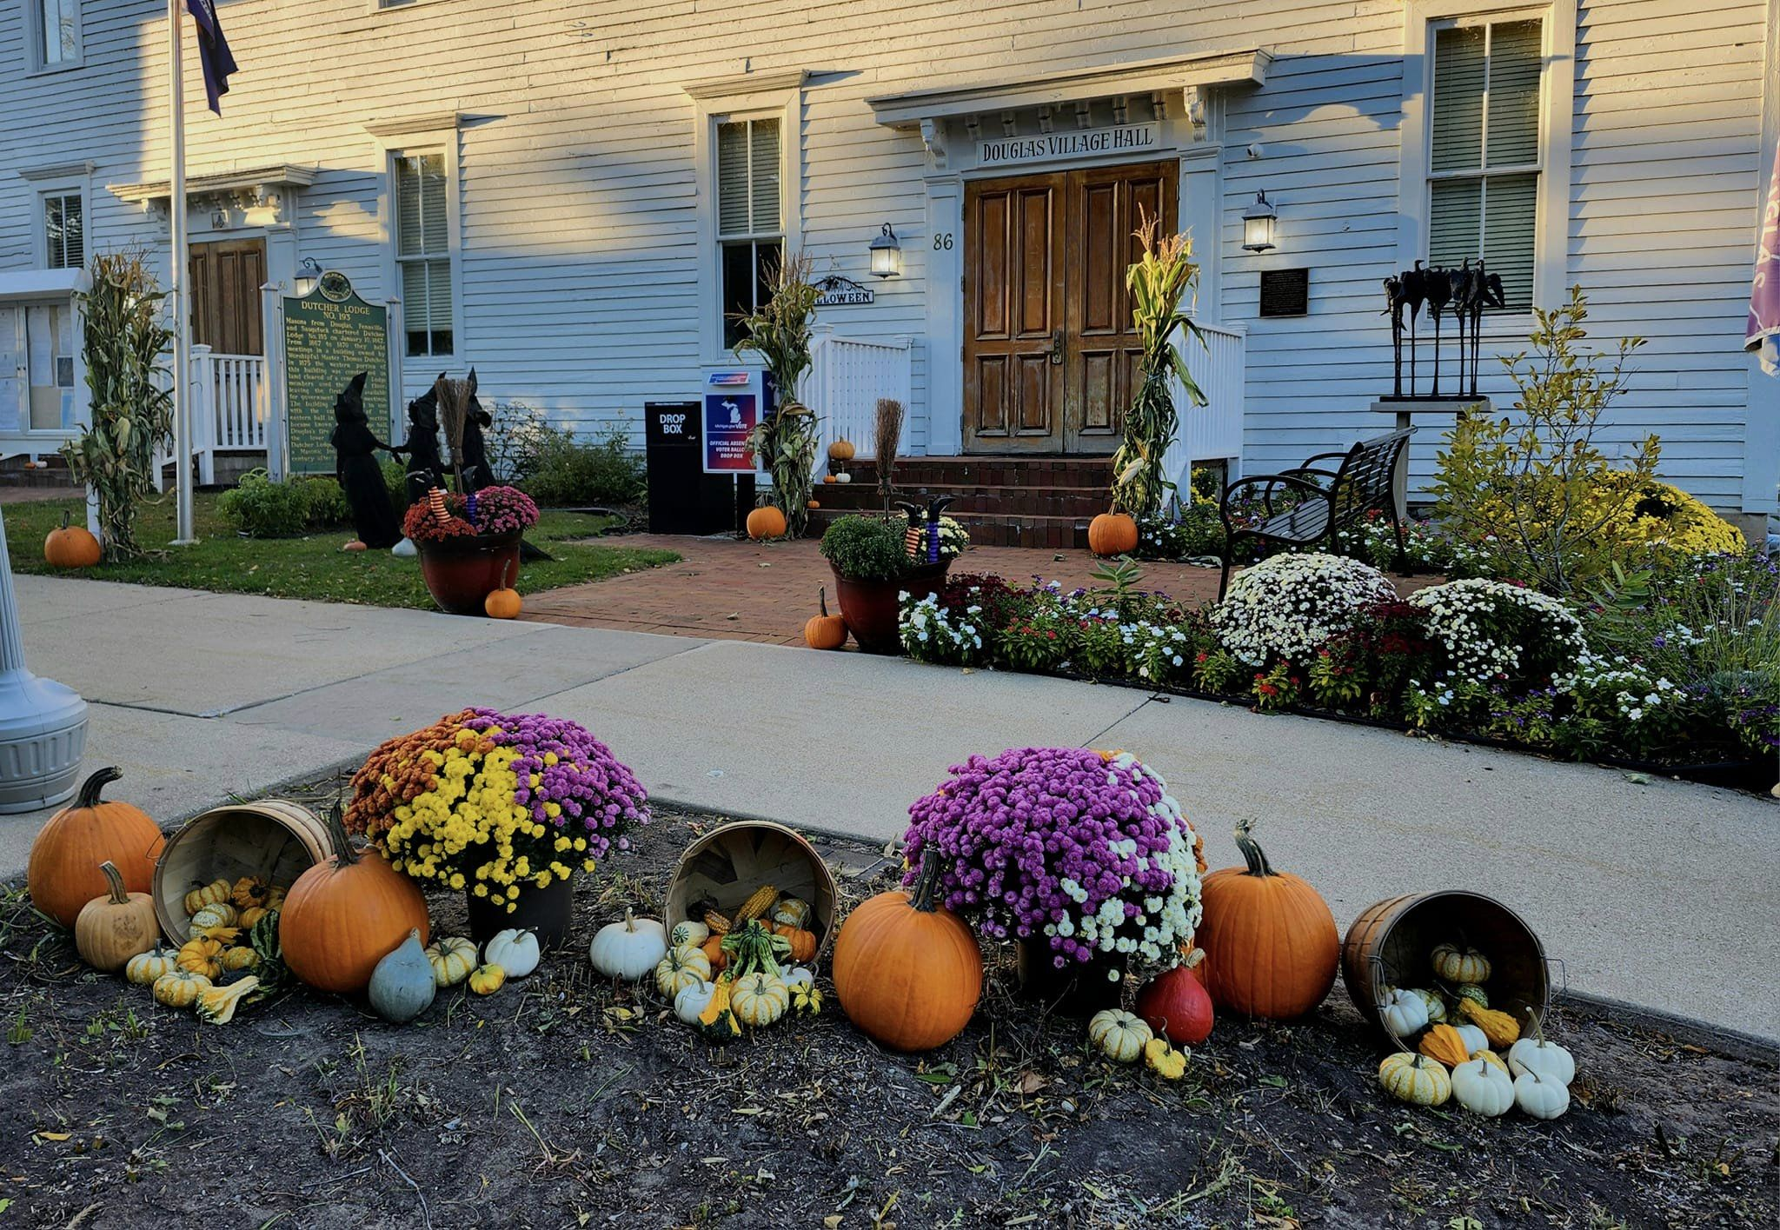
2024 Douglas DDA Accomplishments
New Gateway Signage Project
Installed at Center Street/Blue Star Hwy.
50% funding provided through a grant from the Convention & Visitor’s Bureau (SDACVB).
Infrastructure Enhancements
Partnered with the City to upgrade Beery Field's electrical system to support larger events.
Promotions & Visibility
Created banner space on the DDA Gateway Sign to promote:
Art in Douglas
Farmer’s Market
Beats on Beery
Events hosted by SDACVB
Community Pride
Oktoberfest

Slide 8
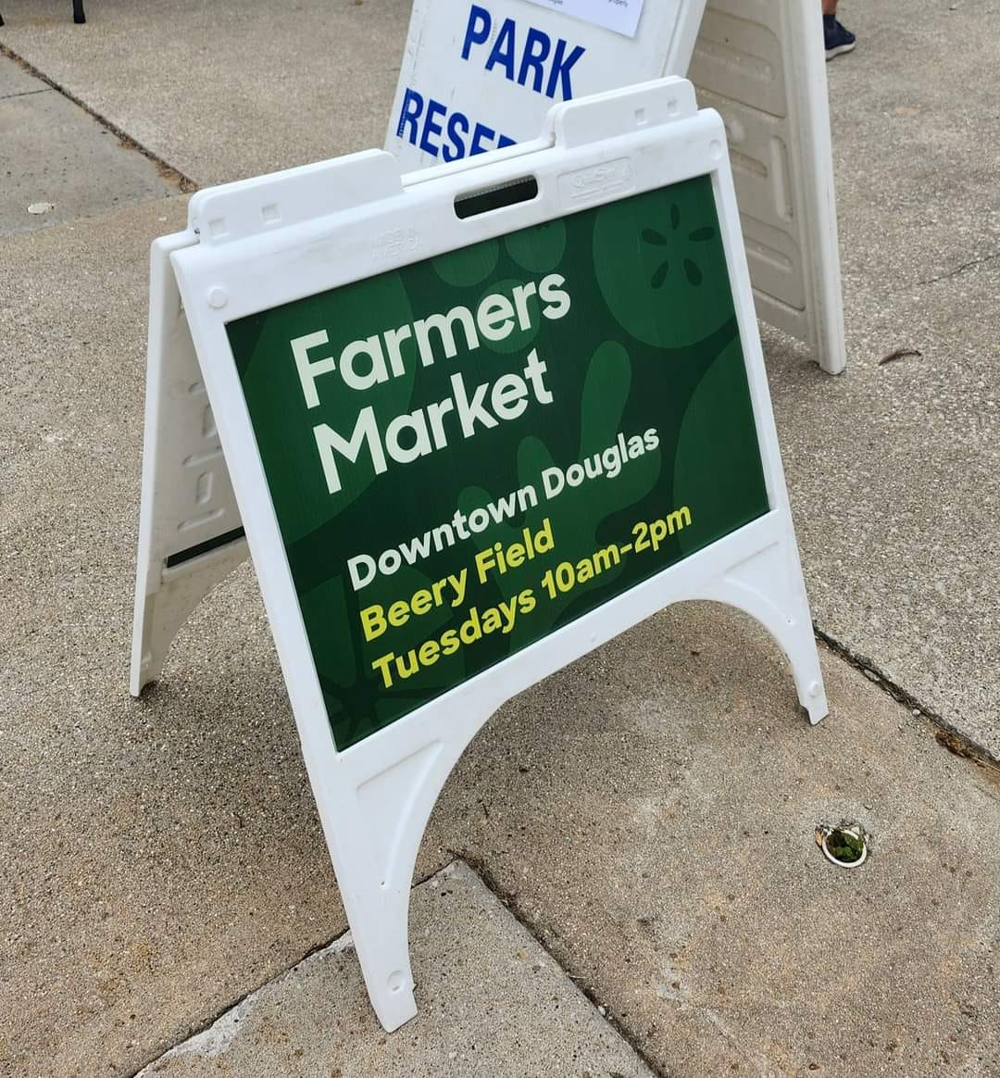
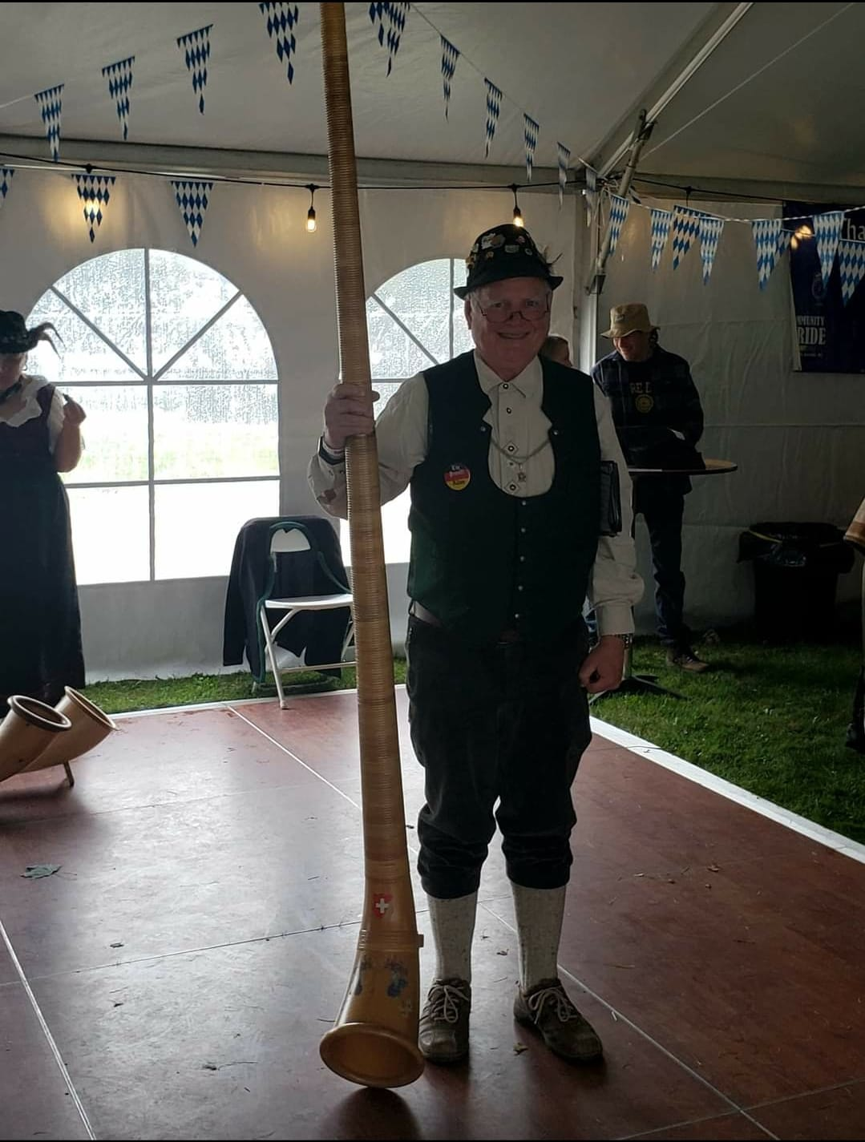
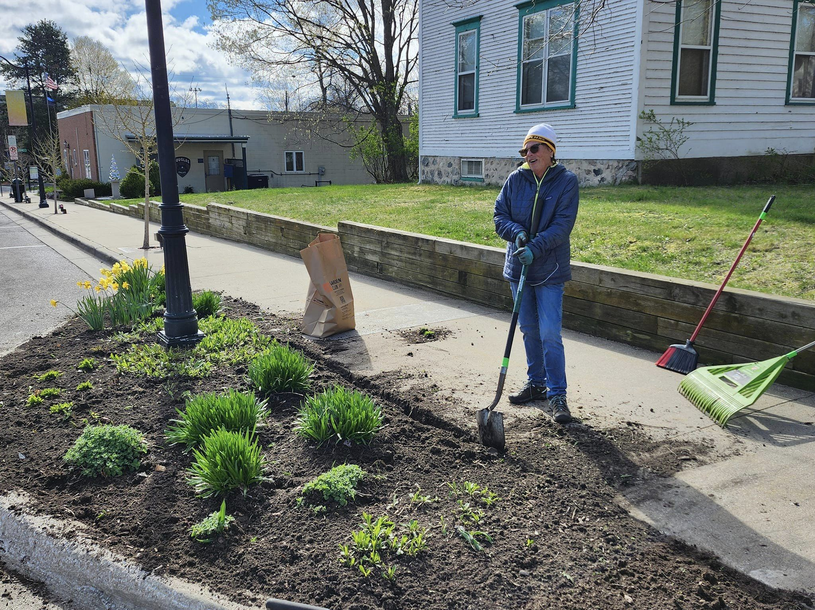
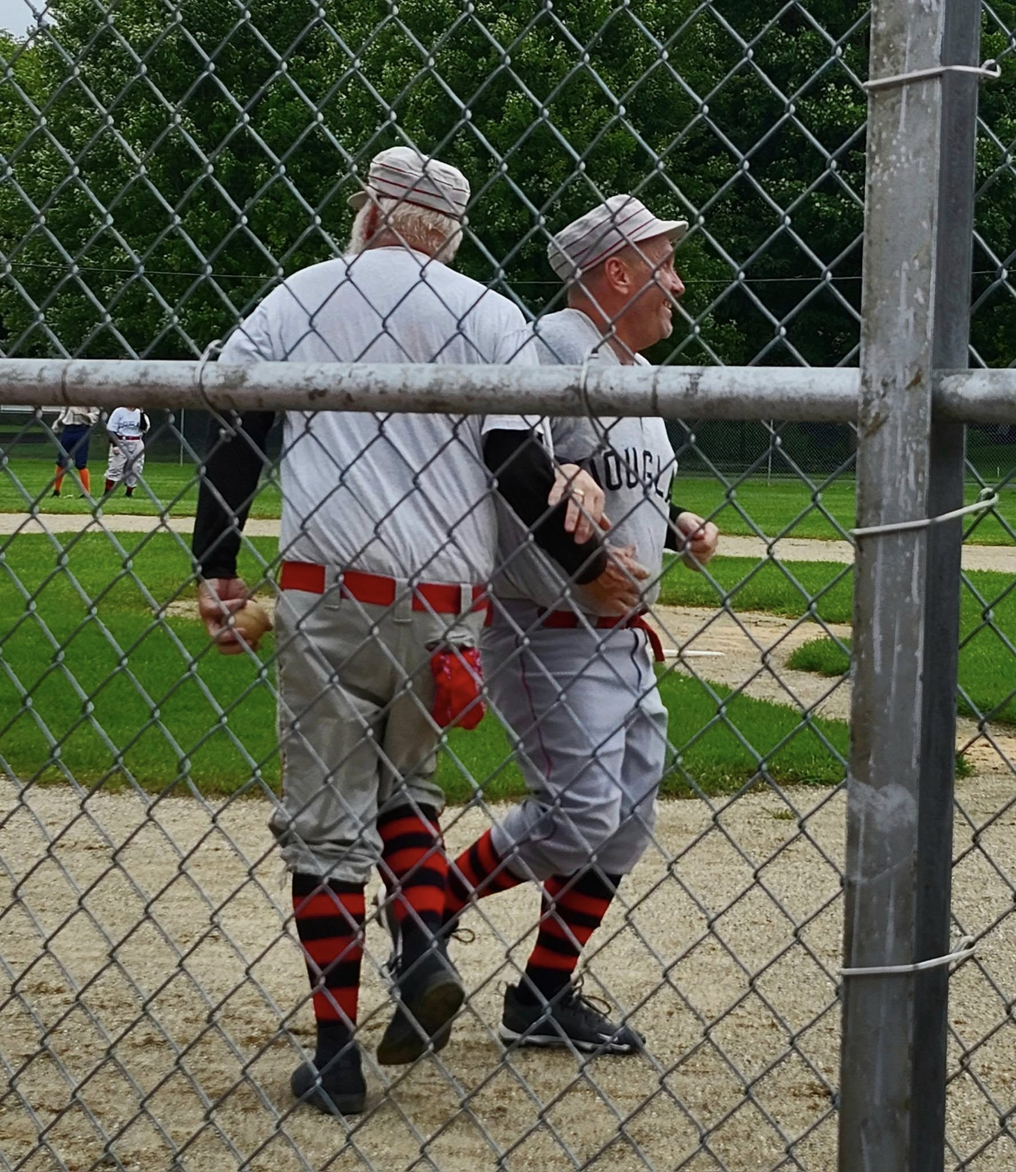
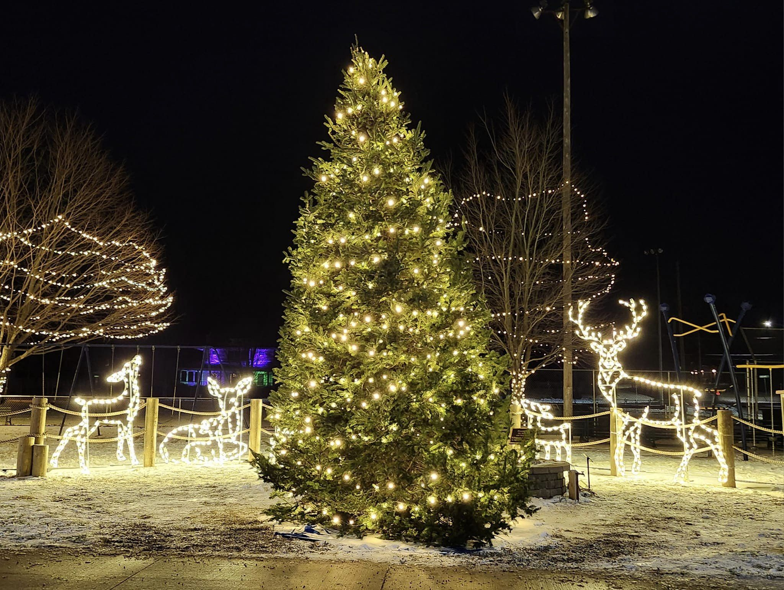
2024 Douglas DDA Accomplishments (cont.)
Community Engagement
Supported Earth Day clean-up efforts, jump-starting downtown beautification.
Backed the launch of the first downtown Farmer’s Market in Douglas.
Financial Contributions
Dutcher’s Baseball Club
Beats on Beery
Art in Douglas events & Gallery Strolls
Oktoberfest/Community Pride
Douglas Light Night Tree Lighting Ceremony
Shop & Dine Passport Program
Local artists painting downtown bike racks
Cavern Tavern Halloween event (Oxbow House)
Seasonal downtown decorations
Derby Day in Downtown Douglas

Slide 9
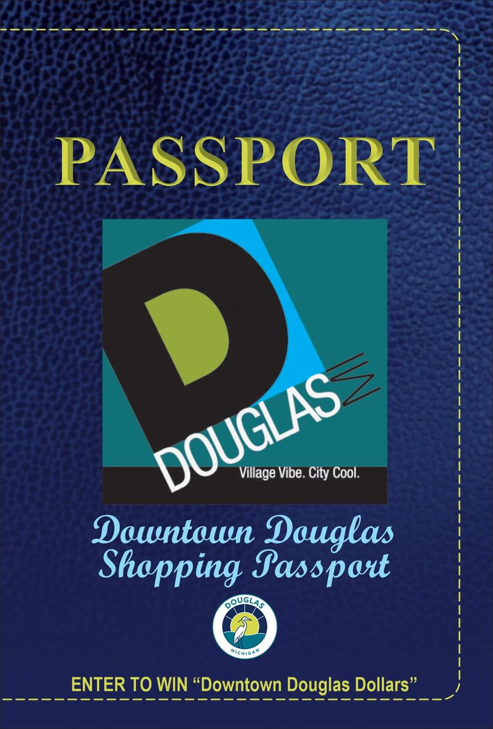
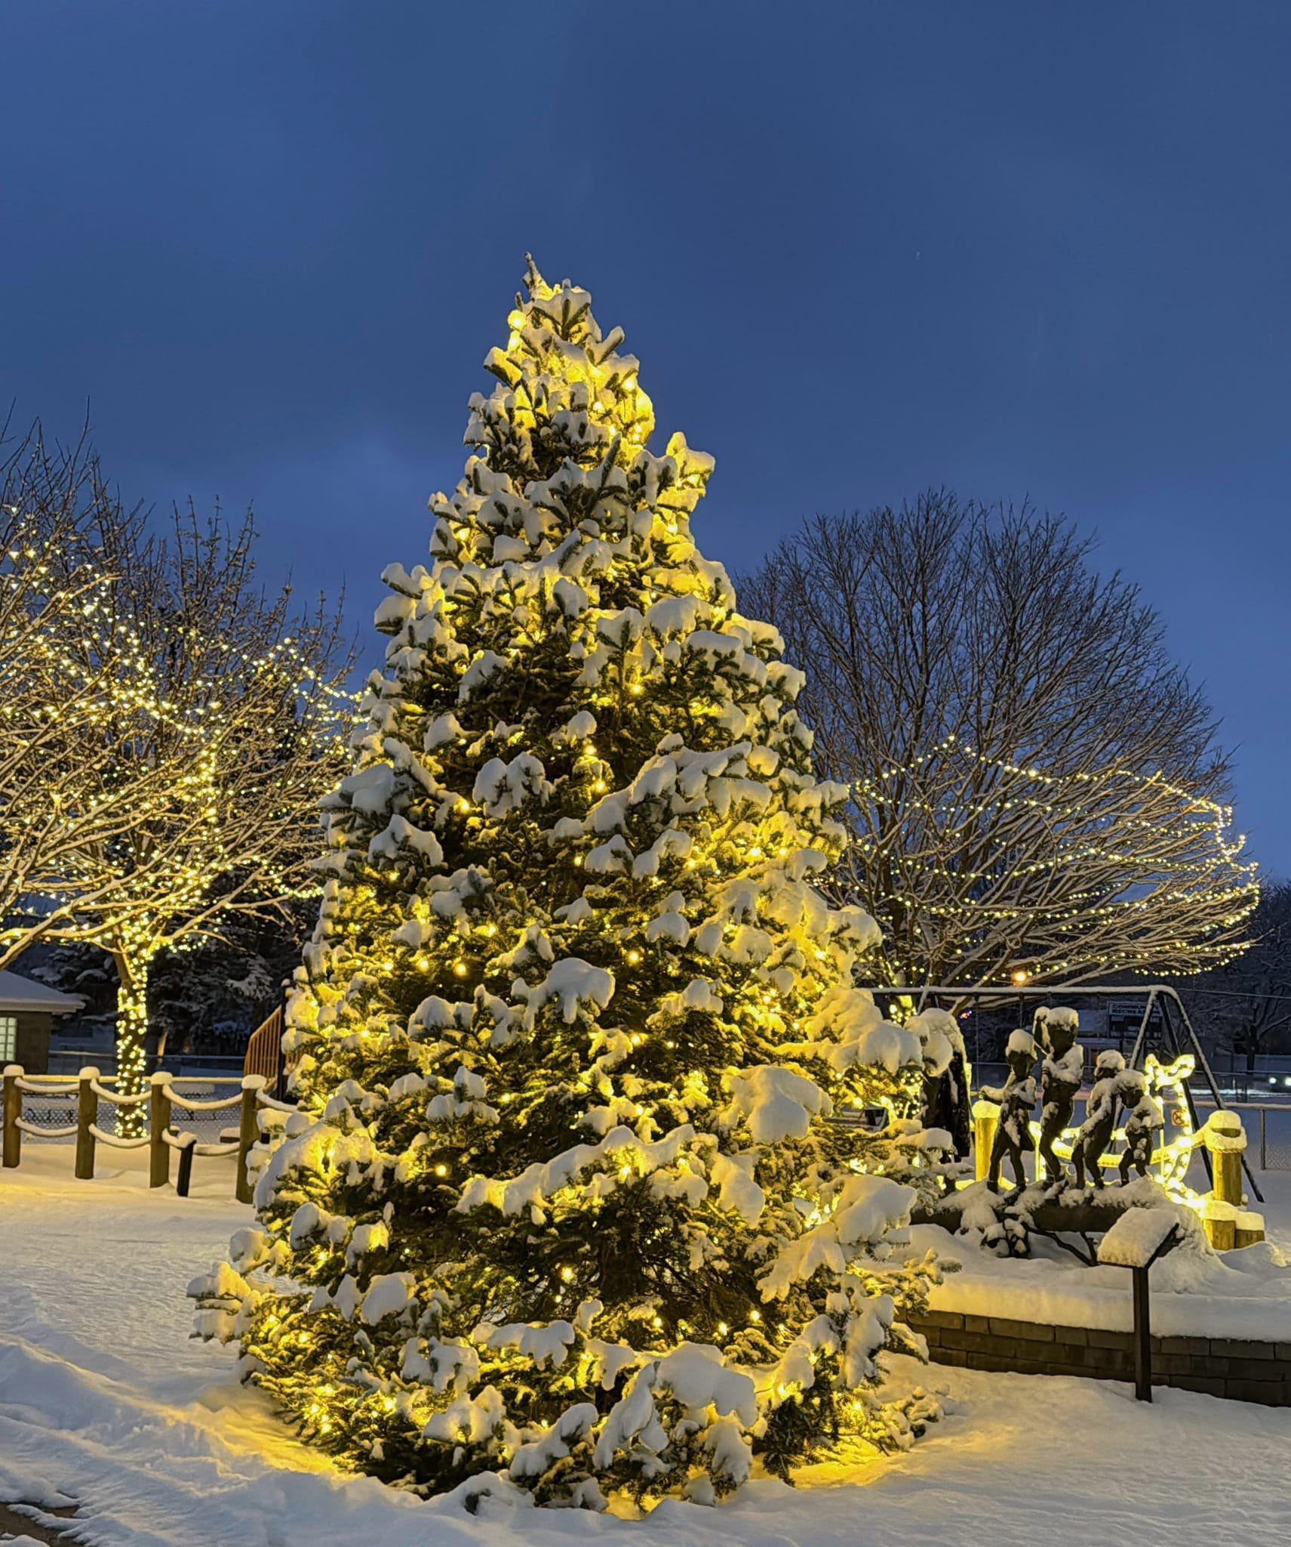
Short Term Goals of the Douglas DDA
Support for Local Businesses:
Enhance the visibility of businesses through marketing campaigns, such as social media outreach and seasonal promotions.
Organize and expand successful programs like the Shop & Dine Passport Program.
Event Planning and Promotion:
Create or support winter events to draw foot traffic during the off-season.
Partner with the Convention and Visitor's Bureau (CVB) to promote local events on a public calendar.
Downtown Beautification:
Add holiday decorations and improved lighting for the winter months.
Address minor maintenance or cleanliness concerns in the downtown area.
Engage Stakeholders:
Hold informational sessions to discuss DDA initiatives and gather input from the community.
Efficient Use of Funds:
Identify short-term grant opportunities to fund smaller projects.

Slide 10
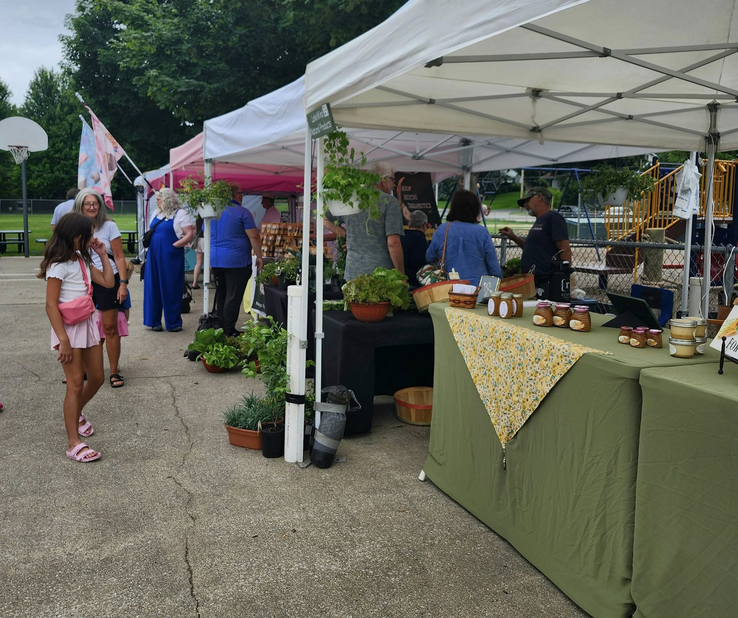
Long Term Goals of the Douglas DDA
Long-Term Financial Strategies:
Continue to work on funding strategies to ensure long-term sustainability for DDA projects, such as Tax Increment Financing (TIF) adjustments or new revenue streams.
Economic Development:
Attract new businesses that align with the city’s vision and fill gaps in the current market.
Partner with stakeholders to encourage mixed-use developments that enhance downtown vibrancy.
Comprehensive Branding:
Implement a cohesive brand identity for Downtown Douglas to strengthen its appeal as a destination.
Public Infrastructure Improvements:
Advocate for improved walkability, including better sidewalks and biking options.
Invest in public spaces for community gatherings.
Sustainable Growth Initiatives:
Support initiatives that enhance downtown.
Expanded Partnerships:
Work closely with regional and state organizations to secure larger grants and funding opportunities.
Support collaborations with the arts community.

Slide 11
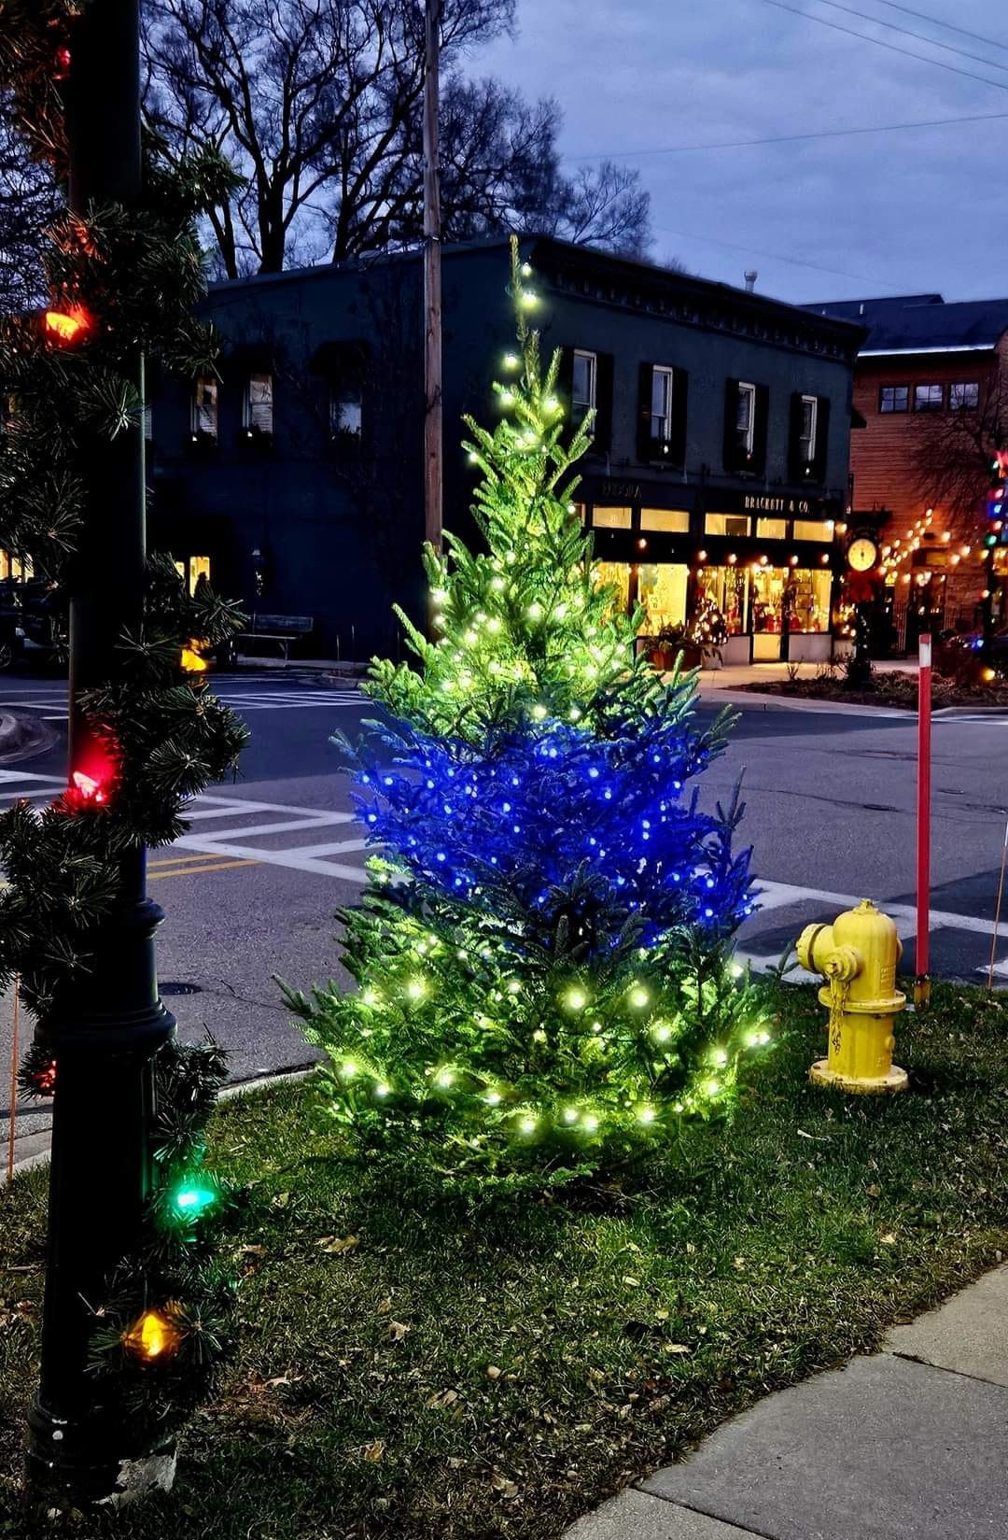
Douglas DDA 2025 Planning: Highlights and Updates
Although the full 2025 plan is still in development, here are some key projects and highlights currently under consideration:
Seasonal Decorations and Enhancements
Christmascape:
Renewed for a 3-year contract at $6,805 annually.
Scope of work remains consistent with current standards.
Infrastructure and Streetscape
Streetlights:
Options and costs under review.
Sidewalk Repairs/Upgrades:
Estimated at $17.25 per square foot.
Technology and Support
Website:
Enhancements are being evaluated for better engagement and user experience.
Intern Program:
Exploring opportunities to bring on additional support for project execution and administration.

Slide 12
Douglas DDA 2025 Planning: Highlights and Updates (cont.)
Add a new digital kiosk sign in the downtown that identifies business locations
Replace the Vinyl Banners with new options
New Main and Center Street Gateway Sign
Offer more trainings to businesses
Hold a DDA Workshop to discuss future priorities and the Tax Increment Finance (TIF) Plan
Discuss and finalize a FY2025/2026 Budget
Create marketing strategies for the downtown
Identify new opportunities and events that will positively impact the businesses in the DDA year round
Continue to identify ways to support additional events in the Downtown through Community Promotions
Expand and grow the Downtown Douglas Shop & Dine Passport Program

Slide 13
Our Area Partners
City of Douglas City Council
City of Douglas Administration
Michigan Downtown Association (MDA)
Saugatuck Douglas Area Convention & Visitor’s Bureau

Slide 14
Questions & Contact Information
If you have any questions, please contact the City of Douglas at 269-857-1438
OR
Email:
citymanager@douglasmi.gov
PZAdmin@douglasmi.gov
https://douglasmi.gov/dda/

